Slide 1
Unit One: Patterns and Relations

Slide 2
What You’ll Learn...
Use patterns to explore divisibility rules.
Translate between patterns and equivalent linear relations.
Evaluate algebraic expressions by substitution.
Represent linear relations in tables and graphs.
Solve simple equations, then verify the solutions.

Slide 3
Try this problem...
Students in grade 7 were raising money for charity. Some students had a “bowl-a-thon”.
This table shows the money that one student raised for different bowling times.
Time (hours) | Money Raised ($)
1 | 8
2 | 16
3 | 24
4 | 32
5 | 40
6 | 48
What patterns do you see?
Extend the table. For how long would the student have to bowl to raise $72.

Slide 4
Divisibility Rules
You can use patterns to determine when a number is divisible by a number between 1-10.
There are no secrets, but, you need to know your times table very well.
You also need to understand what a factor is and how to use factors to your advantage.

Slide 5
Divisibility Rules help you find the factors of a number quickly.
For example:
What are the factors of 25?
What are the factors of 24?

Slide 6
DIVISIBILITY RULES
Number | Rule
2 | If the number is even
3 | If the sum of the digits is divisible by 3
4 | If the number represented by the last 2 digits is divisible by 4
5 | If the ones digit is 0 or 5
6 | If the number is divisible by 2 AND 3
8 | If the number represented by the last 3 digits is divisible by 8
9 | If the sum of the digits is divisible by 9
10 | If the ones digit is 0

Slide 7
Divisible by 2
A number is divisible by 2 if the number is even. All multiples of 2 are even numbers.
Write down 3 numbers that end with an even number.
Check to see if it is divisible by 2 by using long division.

Slide 8
Divisible by 4
A number is divisible by 4 if the last two digits are divisible by 4.
So, to find out if 352 is divisible by 4, check the last two digits.
52÷4 = 13
Therefore, 52 is divisible by 4 so, 352 is also divisible by 4.
Would 4052 be divisible by 4?

Slide 9
Divisible by 5
A number is divisible by 5 if the ones digit is a 0 or a 5.
Some multiples of 5 are: 5, 10, 15, 20 etc.
Write down 3 examples of a number divisible by 5.
Check to see if they are divisible by 5 by using long division.

Slide 10
Divisible by 8
To check if a number is divisible by 8 check the last three numbers.
Is 1192 divisible by 8? Check 192.
192÷8 = 24
192 is divisible by 8, therefore, 1192 is also divisible by 8.
All multiples of 1000 are divisible by 8. So any four digit number only needs the last three numbers checked!

Slide 11
Divisible by 10
A number is divisible by 10 if the ones digit is 0. All multiples of 10 are divisible by 10.
30, 70 and 360 are all divisible by 10.
Write down 3 examples of numbers that are divisible by 10 and verify using long division.

Slide 12
FACTORS
To factor means that you write something as a product. Example: 20 = 2 x 2 x 5, or 4 x 5 or 10 x 2
You can set up the factors into a factor tree or chart. You will get a factor chart later today to practice factoring.
But, now, take your hundred chart labeled 301-400.

Slide 13
You need three different colored markers or colored pencils.
Circle all the numbers that are divisible by 2 with one color.
Then, use a different color and circle all the numbers that are divisible by 4.
Then, use the third color and circle all the numbers that are divisible by 8.
Choose three numbers greater that 400. Which numbers would be divisible by 2, 4 and/or 8?

Slide 14
What patterns do you see?
A number that is divisible by 8 is always divisible by 2 and 4 as well.
Why?
Because, 2 x 4 = 8. Therefore, a number divisible by 8 will ALWAYS be even.

Slide 15
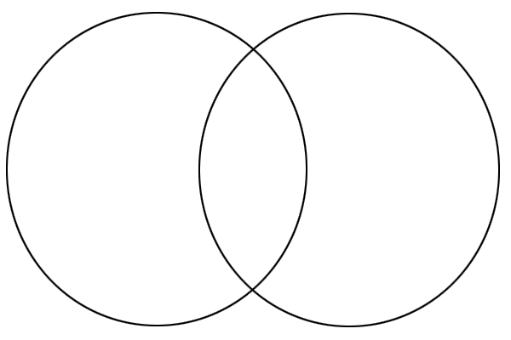
Put the following numbers into the Venn Diagram...
12, 24, 35, 56, 80, 90, 128, 765, 1048, 1482, 3960, 15019
Divisible by 8
Divisible by 5

Slide 16
Today’s homework...
Textbook: Page 8-9 #1, 2, 3, 4 and reflect
Workbook: Lesson 1.1

