Slide 1
Patterns in Division
Lesson 1.2

Slide 2
Division is about making equal groups.
For 20÷4 we make 4 equal groups of 5.

Slide 3
Divisible by 3
A number is divisible by 3, if the SUM of the digits are divisible by 3.
363 = 3+6+3 = 12.
Is 12 divisible by 3?
12÷3 = 4.
Therefore, 363 is divisible by 3.

Slide 4
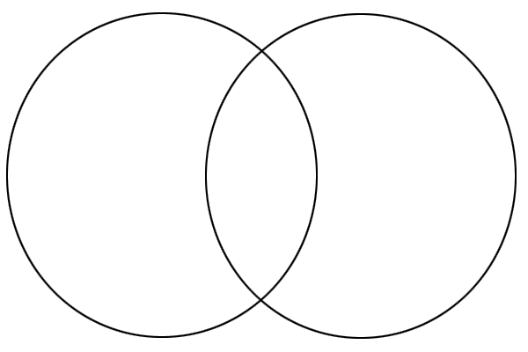
Fill in this Venn Diagram
12, 21, 42, 56, 88, 135, 246, 453, 728
Divisible by 2
Divisible by 3

Slide 5
The Carroll Diagram
This is like a Venn Diagram, but uses a chart instead.
Put these numbers in the correct space. 12, 24, 10, 32, 139, 9212, 224, 120, 1104
 | Divisible by 3 | Not divisible by 3
Divisible by 8
Not divisible by 8

Slide 6
We can use divisibility rules to find the factors of a number.
Think of the factors for the number 100.
100 = 1 x 100
100 = 2 x 50
100 = 4 x 25
100 = 5 x 20
100 = 10 x 10
Therefore, the factors of 100 are
1,2,4,5,10,20,25,50,100
NB: Always list the factors from least to greatest.

Slide 7
Factors ALWAYS occur in PAIRS.
When we find one factor, we find the second factor.
A whole number cannot be divided by 0. We cannot take a number and share it into equal groups.
We cannot make sets of zero from a given number of items.

Slide 8
Solve this...
Malak has 16 miniature pyramids. She wants to share them equally with her cousins.
How many pyramids will each cousin get if Malak has:
A) 8 cousins?
B) 0 cousins?

Slide 9
Answer...
A) There are 16 pyramids. She has 8 cousins.
16÷8=2 Each cousin will get 2 pyramids.
There are 16 pyramids, she has no cousins. She cannot share 16 pyramids with no people. We cannot divide 16 into 0 groups.

Slide 10
Homework
Textbook: Page 12-13 #1,3,5,6,9 and reflect
Workbook: Lesson 1.2

