Slide 1
Adding Integers on A Number Line
Lesson 2.3

Slide 2
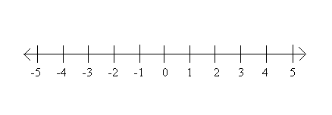
Horizontal Number Lines
Run from right to left.
Positive numbers are on the right of zero.
Negative numbers are on the left.

Slide 3
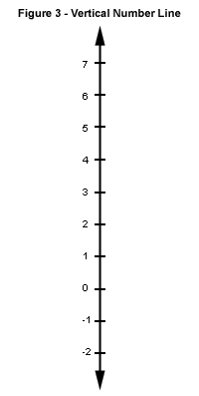
Vertical Number Lines
Run up and down.
Positive numbers are above the zero.
Negative numbers are below the zero.

Slide 4
Addition with a Number Line
To add (+4) + (+1)
To add (+1) + (-4)

Slide 5
To add, you always start at zero.
If the question is (+2) + (+3), you would start at zero and draw an arrow to (+2).
Then, you would start at (+2) and move right three spaces because you are adding a positive numbers. You move RIGHT because the positive numbers are ALWAYS on the RIGHT. We are adding a POSITIVE number. So you move RIGHT.

Slide 6
If you are adding (+1) + (-5), you start at zero and move to (+1).
Then, you move LEFT 5 spaces. You move LEFT because you are adding a NEGATIVE number. NEGATIVE numbers are always on the LEFT of zero.

Slide 7
If your question is (-3) + (+4), you start at zero and move LEFT to (-3).
Then, you move RIGHT 4 spaces. You move RIGHT because you are adding a POSITIVE number. POSITIVE numbers are always on the RIGHT of zero.
Answer is _____________?

Slide 8
Try this on your own...
Add (+4) + (+3)
Add (+4) + (-3)
Add (-4) + (+3)
Add (-4) + (-3)
What do you notice about your answers?

Slide 9
Generally, you will use a horizontal number line.
But, when solving word problems, you may want to use a vertical number line.

Slide 10
The temperature is 12˚C. It falls 5˚C. Find the final temperature.
Your equation would be: (+12) + (-5).
Start at (+12) and move down 5 spaces. This represents the minus 5.
The arrow ends at +7. The temperature is 7˚C.

Slide 11
Youssef is scuba diving. He starts at sea level (0 m). He then swims down 8 m. What depth is he at now?
Equation is (0) + (-8). Start at 0 and move down 8. This represents (-8). You arrow ends at -8.
Therefore, (0) + (-8) = -8
He is at -8 m. Or, he went down 8 meters.

Slide 12
Nour and Mai buy and sell CD’s at a market. One day they bought 3 CD’s for $5 each. They sold 2 CD’s for $9 each.
A) Write the expenses and income as integers.
B) Draw a number line. Add expenses and incomes. Did they make or lose money?

Slide 13
Homework
Workbook 2.3
Textbook page 62 #2, 4, 5, 8, 11 and Reflect

