Slide 1
Separating solutions.

Slide 2
This side shows the Manitoba curriculum idea.
This side shows the notes you should try to write down.

Slide 3
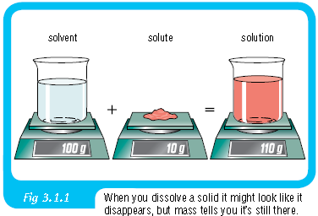
What are solutions?
Identify solutes and solvents in common solid, liquid, and gaseous solutions.
“a solution is a homogeneous mixture composed of two or more substances. In such a mixture, a solute is dissolved in another substance, known as a solvent.”
Sugar water (solution):
Water=solvent
Salt=solute

Slide 4
Define solutions.
Describe solutions by using the particle theory of matter. Include: particles have an attraction for each other; the attraction between the particles of solute and solvent keeps them in solution
Copy the definition to the left.
With our bottle of Tang, the sugar and artificial colour particles are attracted to the water particles. This attraction keeps them in solution.

Slide 5
How can we separate solutions?
Demonstrate different methods of separating the components of both solutions and mechanical mixtures. Examples: distillation, chromatography, evaporation, sieving, dissolving, filtration, decanting, magnetism, sedimentation
There are a few different methods for separating the solutes from solutions.
Distillation
Chromatography
Filtration
Decanting
Magnetism
Sedimentation

Slide 6
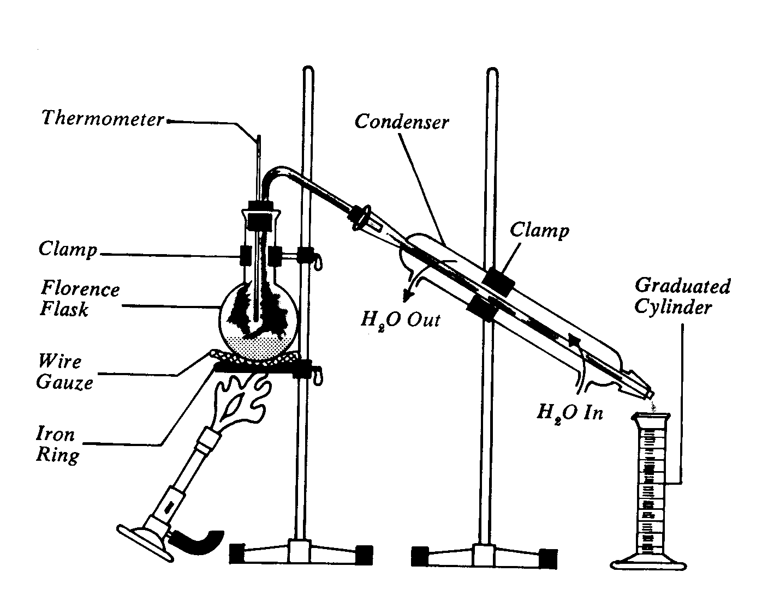
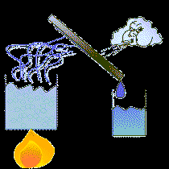
Methods for separation of solute from solvent: Distillation
With distillation, heat separates different parts of a solution.
The water evaporates, for example, and leaves behind the solute.

Slide 7
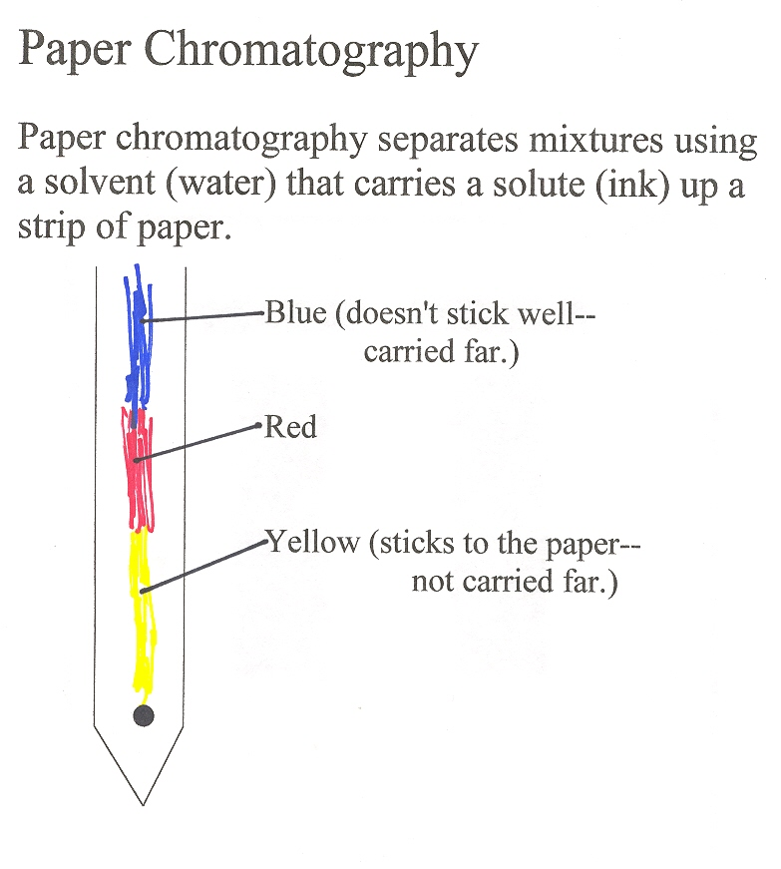
Methods for separation of solute from solvent: chromatography
In this technique, a paper is used to separate certain materials.

Slide 8
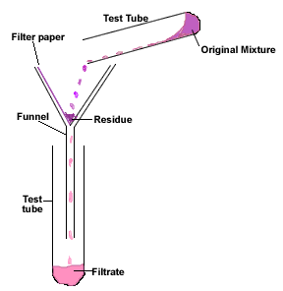
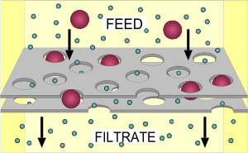
Methods for separation of solute from solvent: Filtration
Filtration separates particles based on their relative size.

Slide 9
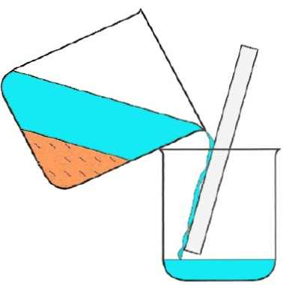
Methods for separation of solute from solvent: Decanting
Decanting involves gently pouring lass dense substances from their more dense substances.

Slide 10
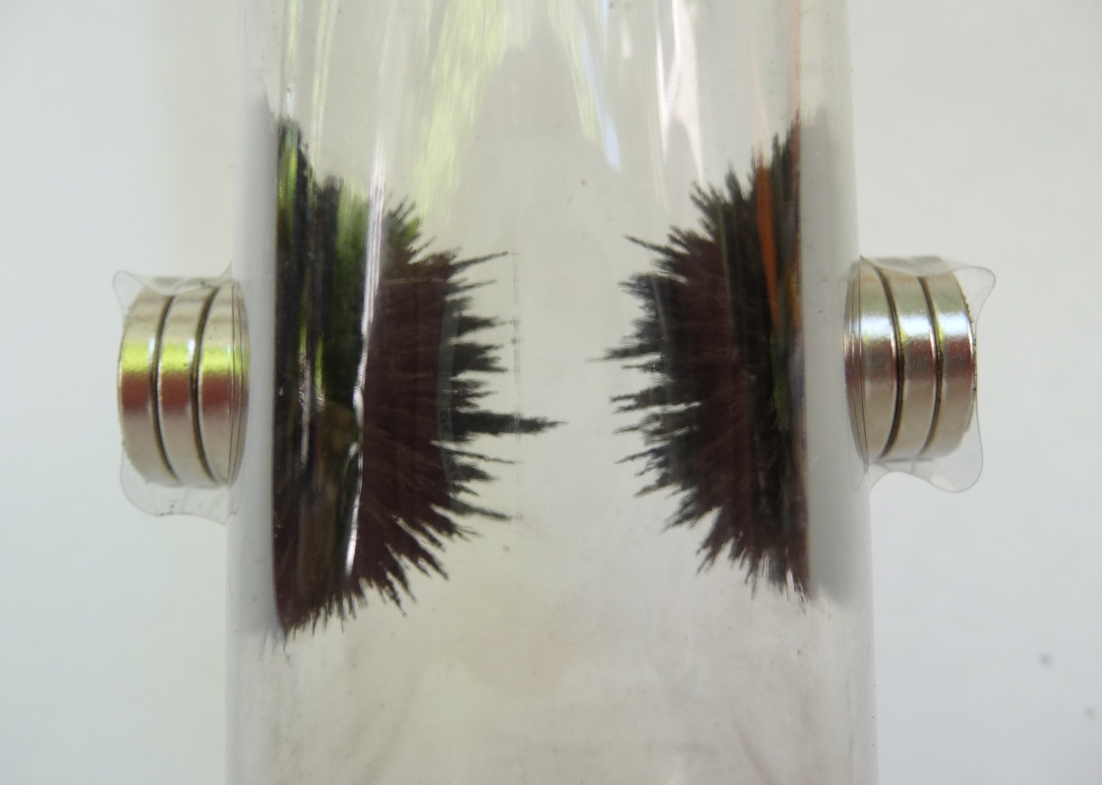
Methods for separation of solute from solvent: Magnetism
Magnetism can be used to separate metals from non-metals.

Slide 11
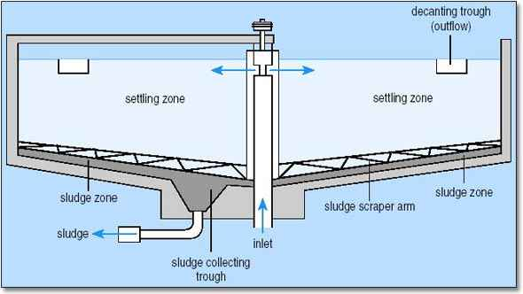
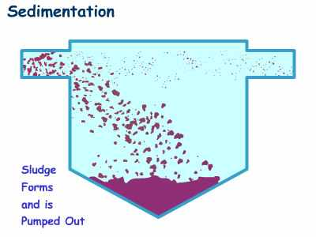
Methods for separation of solute from solvent: sedimentation
Sedimentation uses time and stable water to separate dense solids from less dense liquids.

Slide 12
Describing solutions
Describe the concentration of a solution in qualitative and quantitative terms, and give examples from daily life when the concentration of a solution influences its usefulness. Include: dilute, concentrated, grams of solute per 100 mL
Dilute=a weak solution
Concentrated=a strong solution
Grams of solute per 100ml: a specific way to measure a solution.

Slide 13
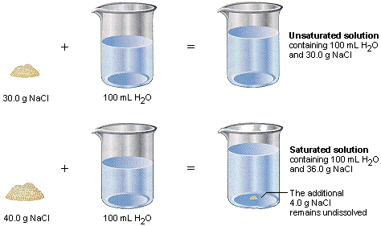
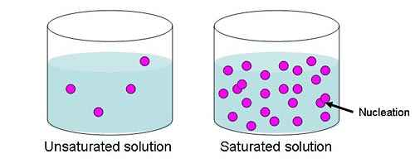
Saturated vs. Unsaturated solutions
Demonstrate the difference between saturated and unsaturated solutions.
Saturated solutions: more solute, sometimes even more than the solvent can handle.
Unsaturated: solutions that are easily handled

Slide 14
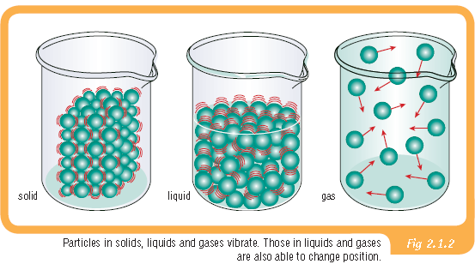
Effects of heating and cooling at a particle level.
Demonstrate the effects of heating and cooling on the volume of solids, liquids, and gases, and give examples from daily life.

Slide 15
Boiling and melting points.
Compare the boiling and melting points of a variety of substances and recognize that boiling and melting points are properties of pure substances. Include: water
Copy the words in bold on the left.
Different substances have different boiling and melting points.

Slide 16
Boiling and melting points.
Substance | Freezing point | Boiling point
Water | O°c | 100°c
Ethanol | -114.7°c | 78.4°c
Acetone | 52°c | 56.2°c
Oxygen | -218.4°c | -183°c
Gold | 1311°c | 3233°c
Iron | 2410°c | 4527°c
Mercury | -38.87°c | 356.58°c
Neon | -248.6°c | -246.1°c

Slide 17
Temperature vs. heat
Differentiate between the concept of temperature and the concept of heat.
Temperature=Temperature is the MEASURE of the AVERAGE molecular motions in a system
Heat=Heat is the amount of energy in a system.

Slide 18
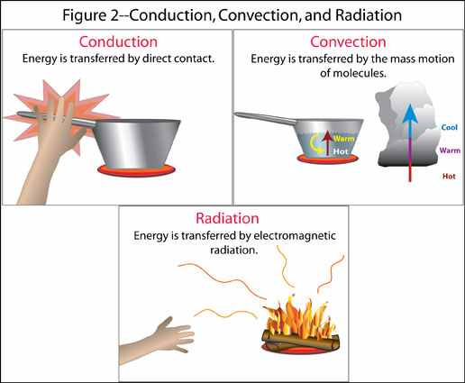
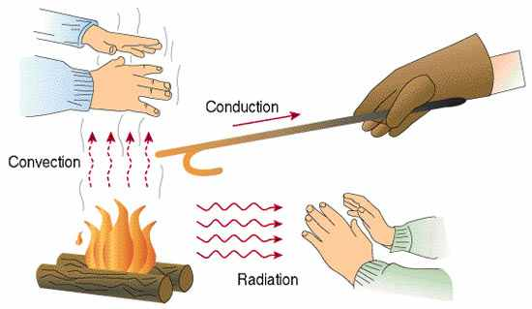
How can heat get transmitted?
Demonstrate how heat can be transmitted through solids, liquids, and gases. Include: conduction, convection, radiation

Slide 19
Heat is a common by-product
Recognize that heat energy is the most common by-product of energy transformations, and describe some examples. Examples: thermal pollution, body heat, friction
Copy the words in bold to the left.

Slide 20
What types of energy can be transformed into heat energy?
Identify different forms of energy that can be transformed into heat energy. Include: mechanical, chemical, nuclear, electrical
Mechanical
When things move, they produce heat
Chemical
Chemical changes produce heat.
Nuclear
When atoms are split, they produce heat
Electrical
When electricity moves, it produces heat

