Slide 1
Angle Bisectors
Lesson 8.4

Slide 2
When you divide an angle into two equal parts, you bisect the angle.
Using a compass is the easiest method.

Slide 3
Using a Compass.
Watch the video on YouTube at the following link.
http://www.youtube.com/watch?v=1TrlT88XVNg
And this link:
http://www.youtube.com/watch?v=2dhB6HHLBGM

Slide 4
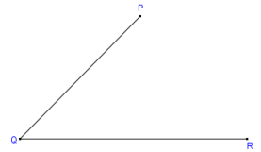
Step by Step
Start with angle PQR that we will bisect.

Slide 5
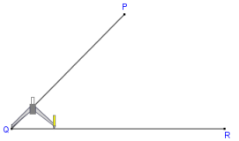
1. Place the compass point on the angle's vertex Q.

Slide 6
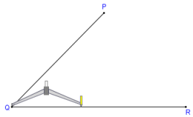
Adjust the compass to a medium wide setting. The exact width is not important.

Slide 7
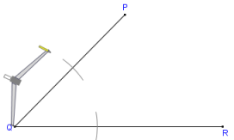
Without changing the compass width, draw an arc across each leg of the angle.

Slide 8
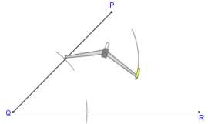
Place the compass on the point where one arc crosses a leg and draw an arc in the interior of the angle.

Slide 9
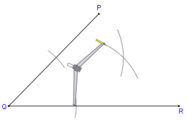
Without changing the compass setting repeat for the other leg so that the two arcs cross.

Slide 10
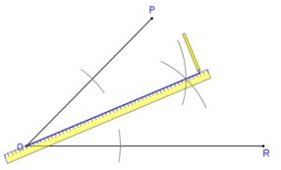
Using a straightedge or ruler, draw a line from the vertex to the point where the arcs cross

Slide 11
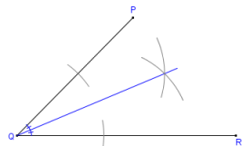
Done. This is the bisector of the angle ∠PQR

Slide 12
If a question asks you to “bisect angle R”, you would put the point of the compass on R.
You can measure all the angles using a protractor to verify that you bisector is correct.
For all questions, use a ruler and compass. Do not worry about the Mira or plastic right triangle.

Slide 13
Assignment
Lesson 8.4 in the workbook.
Accompanying worksheets.

