Slide 1
Quiz Time
#1
What is the formula for finding the area of a circle?

Slide 2
Лr squared

Slide 3
#2
What is the formula for finding the circumference of a circle?

Slide 4
Лd
Or
2Лr

Slide 5
#3
Find the area.
7 cm

Slide 6
153.86 cm squared

Slide 7
#4
Find the area.
9 cm

Slide 8
62.172 cm squared

Slide 9
#5
What is the area?
8 cm
9 cm

Slide 10
36 cm squared

Slide 11
#6
What is the area of a triangle with a base of 8 cm and a height of 2.61 cm?

Slide 12
10.44 cm squared

Slide 13
#7
What is the area of the rectangle, if the area a triangle inside is 12 cm?

Slide 14
24 cm squared

Slide 15
#8
The area of a triangle is 14 cm and the base is 7 cm. What is the height?

Slide 16
49 cm squared

Slide 17
#9
What is the area of a circle with a radius of 3 cm?

Slide 18
28.26 cm squared

Slide 19
What is the area of a parallelogram that has a base of 17 ft and a height of 36 ft?

Slide 20
612 ft squared

Slide 21
Circle Graphs
Interpreting them and drawing them

Slide 22
A circle graph shows data as parts of one whole.
Each sector of a circle graph represents a percent of the whole cirle.
The whole circle represents 100%.

Slide 23
Parts of a Circle Graph
All circle graphs have a TITLE.
Each sector is labelled with a category and a percent.
A circle graph compares the number in each category to the total number.
Sometimes there is a legend that shows what category each sector represents.

Slide 24
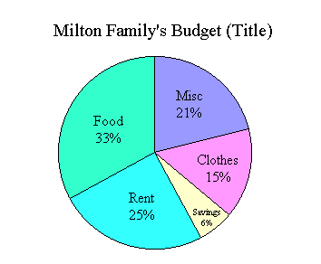
Sample Circle Graph

Slide 25
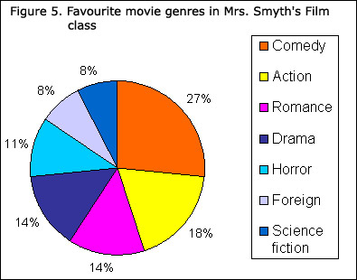
Circle Graph with Legend

Slide 26
Definitions
A percent circle is a circle broken into 100 equal parts. Each part represents one percent.
The sum of all the angles in a circle is 360 degrees. These are called central angles.
A central angle may also be called a sector angle.

Slide 27
Sometimes you are asked to find the angles of a category within a circle graph.
This is how you do it.

Slide 28
Problem
Students in grade 7 were asked how they got to school each day. 9 rode their bikes, 11 walked, 17 rode the bus, and 13 were driven by car.
First, write each number as a fraction out of 50. (Because there are 50 students)

Slide 29
The circle graph will then represent all the types of transport.
To put fractions into the percent circle, convert all fractions to a percent. The sum should be 100%.
You can now graph the results in a percent circle.

Slide 30
To find the angles of each category, convert the percent to a decimal.
18% = .18
Multiply the decimal by 360 degrees.
Round to the nearest whole number.
.18 x 360 = 64.8 = 65 degrees.

Slide 31
Once you have determined the angles for each category, the sum of all the angles should be 360 degrees.
To draw the circle, use a compass.
Use a protractor to construct each central angle.

Slide 32
Start with the smallest angle.
Draw a radius and measure the distance of the angle.
Start the next angle where the other one finished.
Label each sector with a name and percent.
Write a title for the graph.

