Slide 1
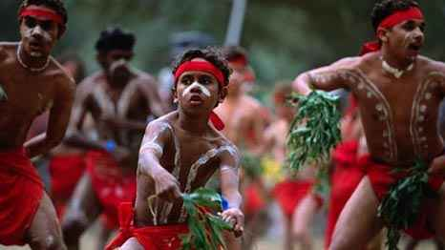
Cultural Identity
What it means to be you...

Slide 2
What is culture?
A way of life shared by a group of people.
Culture changes over time.
Culture gives us our identity.

Slide 3
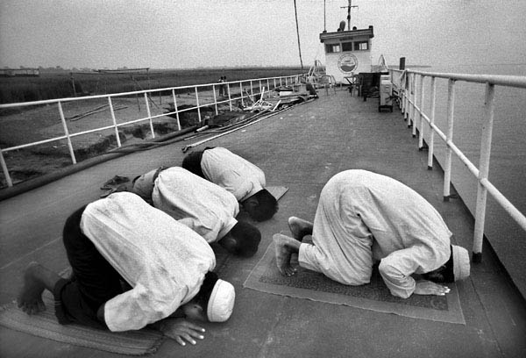
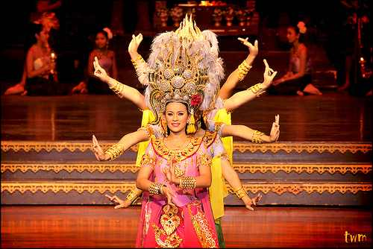
How does culture form identity?
Language
Location
Religion
Family and community
Art, Music, Dance
Food
Dress
Way of Life
Values

Slide 4
Cultures are connected to a specific place.
A person can live in Canada but have a strong connection to where they are from.

Slide 6
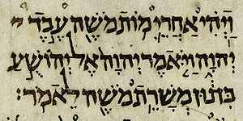
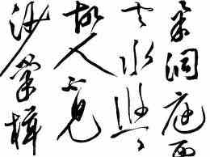
Language
Language is one of the most important elements of a culture.
When you share a language you can communicate and understand their values.

Slide 7
Forcing language
Forcing people to stop using their language has been a powerful way to control them.
When another culture forces their language on another culture, the language eventually dies out.
In Ireland, where they spoke Gaelic, the British came and forced English on them.
In the former Soviet Republics, people were forced to speak Russian.
In Canada, Aboriginal children were forced to speak English or French. Many Aboriginal languages did not survive.

Slide 8
Religion
Religious beliefs are very important to a culture.
Some people are persecuted because of their beliefs.
Some people move to follow the religion they believe in, others stay where they are.

Slide 9
When Cultures Meet...
Cultural groups used to be far away from each other.
But, since the 1500’s, the cultural map of the world has been changing because people started migrating.
Mobility brought people from different cultures together.

Slide 11
Exploration
Explorers moved into North, Central and South America starting in 1400 BC.
They made contact with people living on the lands.
As cultures came together, people started sharing ideas with each other.

Slide 12
In most cases, one culture forced its ideas and ways of life on the other cultural group.
This changed the way some cultures had existed for a long time.
Some cultures were destroyed.

Slide 13
There are countless stories from around the world that share what happens when cultures meet.
Canada only became a country in 1867. Before that, it had colonies from France and Britain, as well as a large Native Population.

Slide 14
When the Europeans came to Canada, the Aboriginal people shared their knowledge of the land with the Europeans.
As time passed, the traditional ways of life for the Aboriginals changed. They signed treaties they did not understand and were moved onto reserves.

Slide 15
The Europeans thought that the Aboriginal people were SAVAGES.
The government forced children to go to Residential Schools.
These schools forced children to speak French or English and taught them how to be white.

Slide 16
When culture is taken away...
The children at the Residential Schools lost their Aboriginal language.
They did not know how to live off the land like their ancestors.
They did not know about their religious beliefs.
The longer they stayed, the more of their culture they lost.

Slide 21
Cultural Isolation
Some countries, like Japan, Korea, China and Mongolia have not been as affected by other culture groups.
These countries had policies to keep foreigners out.
Contact with foreigners was unwelcomed.

Slide 22
They isolated their culture to protect it.
The great distance between North America and Asia was also beneficial to the Asian countries.
If a Westerner wanted to go to Asia, it was a long journey and the advent of air travel, most stayed home.

Slide 23
Spreading Ideas
Sometimes cultures borrow from one another.
Some cultures taught others how to farm or hunt or fish.
Some cultures taught others how to build boats or plows.

Slide 24
The peaceful sharing of ideas is called, Cultural Diffusion.
Sharing ideas helps everyone. Tools and technology spread because people shared with one another.
The Europeans brought rifles to the Americas and taught Aboriginal hunters to use them. They quickly adopted the rifle instead of the bow and arrow.

Slide 25
Destruction of Cultural groups
Stronger countries have prevailed throughout history.
Some cultures were lost completely, others hardly remembered.
The Europeans were the biggest culprits of cultural destruction.

Slide 26
The European hunt for riches destroyed most cultural groups they encountered.
The Europeans also brought disease with them.
When European explorers landed in North America they carried diseases that had not been in North America.

Slide 27
These diseases, like small pox, tuberculosis, measles and the common cold were unknown in North America.
When the Europeans came, so did disease and it killed thousands of Aboriginals throughout North and South America.

Slide 28
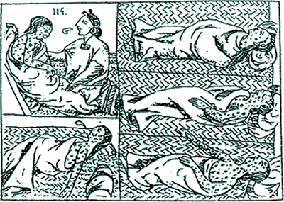
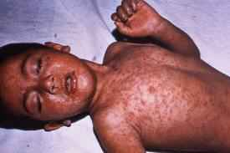

Slide 29
Assimilation
Assimilation is the movement of one cultural group into another cultural group.
This can happen because one group is overpowering, or, because people want to be a part of the group.

Slide 30
Resistance of one people group towards another is called Racism.
Racism has led to multiple Genocides.
A genocide is a mass killing of a people group.

Slide 31
GEnocide
Genocide happens more often than you think.
One people group exterminates another because they are different.
It has repeated itself throughout history and is the greatest form of cultural destruction.

Slide 32
Timeline of ethnic cleansings...
1857 – 1867: Russian soldiers kill 400,000 Circassians
1915 - 1917: 2 million Armenians living in Turkey are eliminated.
1932 – 1933: 7 million Ukrainians starve to death because of forced farming system of Joseph Stalin.
1937 – 1938: Japanese murder 300,000 or 600,00 people living in Nanking, China.

Slide 33
1938 – 1945: The Holocaust where Germans exterminate 20 million Jews.
1987 – 1989: Saddam Hussein’s regime kills 100,000 people of the Kurdish population.
1994: Rwandan Genocide. 800,000 Tutsi’s killed in 100 days.

Slide 34
2003 – present: Darfur, Sudan. Janjaweed is trying to eliminate all people who are Darfurians.
Canadian Genocide – 1960 – 1989. Forcing the elimination of Aboriginals through the Residential School System.

Slide 35
If we don’t learn from the past...history repeats itself.
Every country has a story of differences and cultural struggle.
It does not mean we can kill people because they are different.
Everyone has the right to life.

Slide 36
Mainstream population
The major cultural group in an area is known as the mainstream population.
When a new culture arrives, they are not the mainstream population, but they bring changes to the existing culture.
Some are good, some are not.

Slide 37
Xenophobia is the fear of people who look or act differently.
Xenophobia is one of the leading causes of racism.
The idea of racial purity is strong in some countries. This is a racist attempt to keep their culture intact.

Slide 38
Some religions use their teachings to foster racism.
They do not want others to have different beliefs that challenge their own way of thinking.

Slide 39
Universal Declaration of Human Rights
December 10, 1948, the Universal Declaration of Human Rights was accepted by the UN.
The UDHR was created in response to the mass genocide of Jews during the Holocaust.
People were afraid of what might happen next if there were no rights for people.

Slide 40
The purpose of the UDHR is to protect people from:
Abuse
Discrimination
Persecution

Slide 41
It also anted to provide:
Freedom
Live without fear
Work for a better life
Peace
Justice
Higher standard of living

Slide 42
The UDHR also defines rights of a person in respect to:
Mobility
Education
Nationality
Peaceful assembly
Standard of Living
Democratic Citizenship
Family Life
Marriage

Slide 43
Organizations like, Amnesty International and Human Rights Watch have a mission to defend human rights of all people around the world.

Slide 44
Despite the UDHR, wars and atrocities still happen.
Genocide, human rights abusers, racism, and other cruel acts are still widespread.
However, war criminals now have to account for their actions in trials and in court.

Slide 45
Powerful leaders that led genocides have faced trial and have been put in prison, and some have even been executed for their crimes.
Before the UDHR, these people would not have been punished for their crimes.

