Slide 1
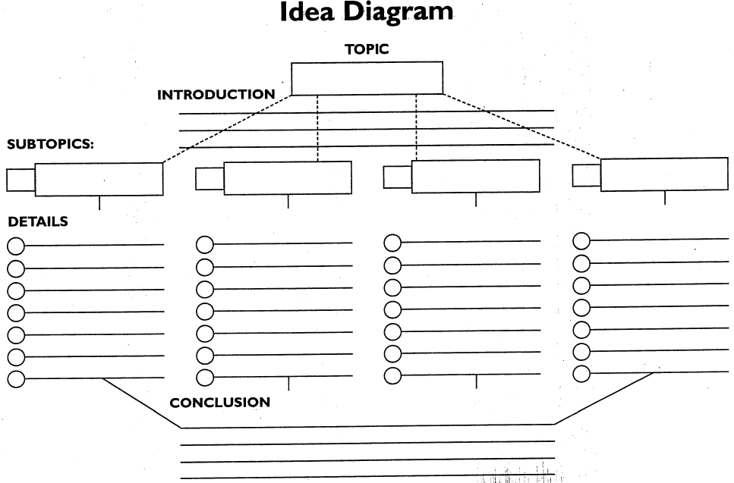
Using the Idea Diagram for Formal Writing

Slide 2
What does formal writing look like?
Formal writing uses specific verbs and nouns.
Formal writing does not contain slang or “hallway talk.”
Formal writing attempts to explain something as clearly as possible.

Slide 3
How is formal writing usually arranged?
It can be arranged in many ways, but ultimately it follows this format:
Introduction of topic
Evidence for topic
Conclusion that attempts to give the reader something to think about.

Slide 4
Formal Writing and our “Idea Diagram”

Slide 5
Idea diagram parts
Topic=What you’re trying to talk about.
Introduction=You introduce the ideas that you will discuss.
Subtopics=The evidence you use to prove your topic.
Details=The details that support each
Conclusion=You wrap up your topic and give the reader something to think about.

Slide 6
Each section implies a paragraph.
Paragraph 1
5?
3
4
2
6

Slide 7
First, choose your topic.
Top three parts of a perfect vacation.
Choose a topic you can really write about.
Specific topics tend to be easier to write about than general ones.
“The top three parts of a perfect vacation” is easier to write about than “vacations.”

Slide 8
Skip the introduction for now.
You don’t know what you’re introducing yet, so what is there to say?

Slide 9
After your topic, choose your subtopics.
Seeing new things
Rest and relaxation
Not having to go to school
Trying different foods
Subtopics are the evidence you use to support your topic.
Choose four smaller topics within your topic.
Try to write as many complete, note-styled details as possible for each one.
Throw out the subtopic that you can write the least about, or combine it with another similar subtopic.

Slide 10
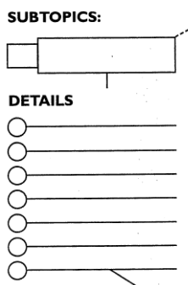
Details for subtopics.
Details are related to your subtopic, and always support your main topic.
The clearer the detail, the easier it will be to write about it.
You get to see new things
Feel more alive with N.T.s
Can share experiences with others.
N.T.s help memories stick
N.T.s are easier to spend more time with.
N.T.s lead to more N.T.s
I’ve enjoyed N.T.s before.

Slide 11
Now that you know your subtopics, write your introduction.
You can now make a draft of your introduction. It should be a few sentences long.
Your introduction will introduce your subtopics.
You don’t need to make it all fancy on the Idea diagram.
Although I’ve experienced some good vacations, the perfect vactation would have the following three elements: new places to visit, a chance to rest and relax, and an opportunity to try new foods.

Slide 12
And finally, your conclusion.
Vacations can surprise us. However, good food, new things to look at, and a chance to relax can make a good experience out of any surprise. Besides, at least vacations are better than school, even with the chances we might take on them.
Your conclusion should wrap up your main ideas, and should also give the reader something to think about. The conclusion might take awhile to sound right, but you should try to write one here so your brain starts thinking about it.
Note the lines that remind you to make sure you mention your subtopics in your conclusion.

Slide 13
In the end, you have a good set of notes on which to base your piece of formal writing.

