Slide 1
Graphing on a Coordinate Grid

Slide 2
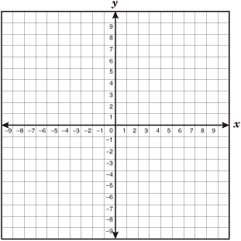
A vertical number line and a horizontal number line that intersect at right angles at “0” form a coordinate grid.

Slide 3
The coordinate grid is also called a
Cartesian Plane
When drawing the axes, they do not need arrows.
A pair of coordinates is called an ordered pair.

Slide 4
The horizontal axis is the x-axis.
The vertical axis is the y-axis.
The axes meet at the origin (0,0).
The axes divide the plane into four quadrants that are numbered counterclockwise.

Slide 6
When you plot on a grid, both lines function like number lines.
On a horizontal number line, the positive numbers are on the right of zero and the negative numbers on the left.
On a vertical number line, the positive numbers are above the zero and the negative numbers are below the zero.

Slide 8
To plot A(4,6), you would move to the number 4 on the horizontal number line and up to number 6 on the horizontal number line.
This is the first quadrant and you should make a dot at this point and label it with an A.

Slide 10
To plot B (-4, -6) you would move on the horizontal number line to -4 and down to -6 on the vertical number line.
Make a dot at this point and label it with a B. This is the third quadrant.

Slide 11
Plot these points on the Grid Provided...
In quadrant 1, plot point A at (2,7).
In quadrant 2, plot point B at (-2,7)
In quadrant 3, plot point C at (-2,-7)
In quadrant 4, plot point D at (, 2 -6)

Slide 12
On the Grid provided, label these points. Which quadrant is each point in?
A(6, 3)
B(-2, 5)
C(4, -5)
D (-1, -7)

Slide 13
The scale does not need to increase by one.
The scale on the axes may increase by any number as long as it is consistent.
You can choose any scale that is suitable for the coordinates provided.

Slide 14
Homework
Workbook 8.5
Textbook page 318 - 319 #1,2,3,4,5,6,11,12
Also, complete the Reflect on page 319. Write a minimum of 3 sentences.

