Slide 1
Movement
Cluster 1 – Unit 3

Slide 2
Movement
The movement of people, animals, or things to a NEW area is called migration.

Slide 3
Immigration is moving TO a new place. For example, moving TO Canada from Egypt.
Emigration is moving FROM a place to a new place. For example, moving FROM Egypt to Canada.

Slide 4
People on the move
Forces that encourage you to leave a place are called PUSH FACTORS.
Forces that draw you to another place are called PULL FACTORS.

Slide 5
If you were in the middle of the picture, would you stay or leave your city?

Slide 6
Push factors
Population growth in foreign countries forced people to find more land.
Agricultural changes such as newer inventions forced Europeans off their land by the land owners because the owners wanted to farm the land.
Bad crops. On the other hand, some crops failed which then made people look for new opportunities.

Slide 7
Push Factors continued
Religious freedom. Other people fled their countries in search of religious freedom.

Slide 8
Pull factors
Freedom. As Gjert Hovland wrote, “Everyone has the freedom to practice the teaching and religion he prefers.”
Economic opportunity. People who move often are in search of a new life and a brighter future.
Abundant land. The amount of unoccupied land was another factor which pulls many people to new countries.

Slide 9
BARRIERS
Barriers are things that make it difficult to move such as:
Family ties
Travel costs

Slide 10
Usually, more than one factor influences a person’s decision to move.

Slide 11
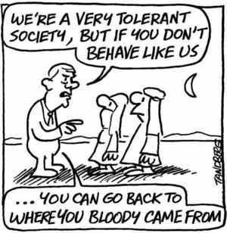

Slide 12
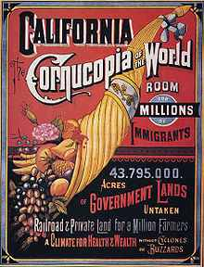

Slide 14
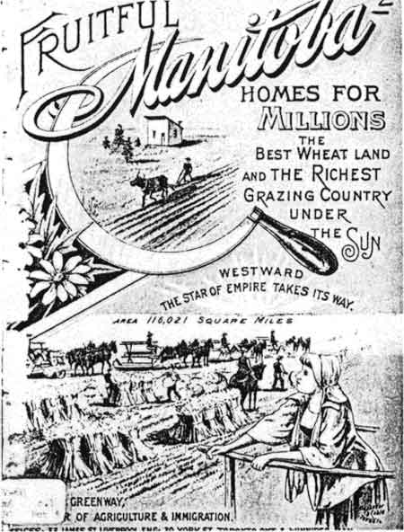

Slide 16
Demography
Demography is the study of human population.
Demographers are scientists who study data on population. They also study issues related to where, and how well, people live.

Slide 17
Population Distribution
Where people live is called population distribution.
How many people live in an area is called population density.

Slide 18
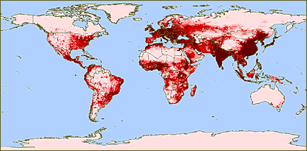

Slide 19
http://www.worldometers.info/world-population/
This website has world meters that indicate world population.

Slide 20
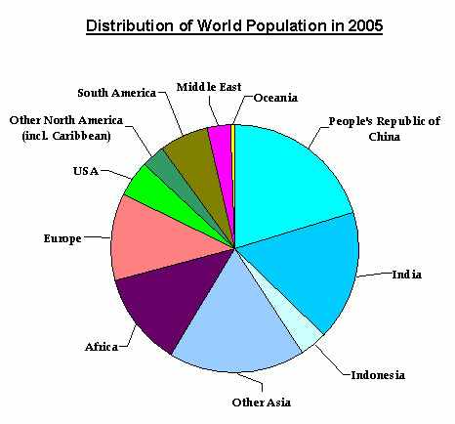

Slide 21
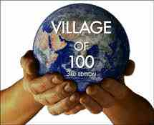
If the world were a village

Slide 22
Population density
Population density tells us how many people live in an area. It is measured by number of people for each square kilometer.
You can calculate this by dividing the number of people living in a country by the land area in which they live.

Slide 23
For example:
Australia has a population of 19 million people and an area of 7 682 000 km squared.

Slide 24
Canada and Australia have large area, but, have small populations.
These countries have SPARSE POPULATION density.
Bangladesh and Thailand has more people in a smaller area. These countries have DENSE POPULATION.

Slide 25
A MODERATE POPULATION density is somewhere in the middle and average between 15 and 150 people per square kilometer.

Slide 26
An unequal world
Where you are born determines a lot of who you are today and who you will become.
Depending where you are born impacts what and how well you eat, whether you go to school or not or whether you will grow up around violence or in safety.

Slide 27
The “have” countries are grouped together as the more developed world.
The “have not” countries are grouped together as the less developed world.
More developed countries have a higher standard of living.

Slide 28
Population grows when more people are born than die.
If the same number of people are born and die, population stays the same.
Population declines when more people die than are born.

Slide 29
Population Growth
Since 1800, the growth in world population has been more rapid than the past.
Reasons are:
1) increases in agricultural production
2) improved nutrition
3) better hygiene
4) improved public sanitation

Slide 30
This rapid growth has been called a POPULATION EXPLOSION.

Slide 31
Some definitions
Crude Birth Rate – the number of births in a year per 1,000 people.
Crude Death Rate – The number of deaths a year per 1,000 people.
Rate of Natural Increase – The annual rate of population growth. It is equal to Crude Birth Rate – Crude Death Rate.

Slide 32
Replacement Rate – The number of children needed per woman to maintain the current population level.
Total Fertility Rate – The average number of children a woman gives birth to.

Slide 33
Life expectancy
This is the amount of time a newborn is expected to live in various places around the world.
Every country has a different life expectancy.
More developed countries have a higher life expectancy than less developed countries.

Slide 34
Overall, life expectancy is increasing, but challenges are still there.
People in Sub-Saharan Africa have life expectancies in the 30’s. This is very low compared to world standards.

Slide 35
Demographic Transition is looking at the four stages of fertility and mortality changes over time.
It includes moving from a situation of high birth rates to low death rates.
For example: The Baby Boom

Slide 36
Living Longer
People are living longer due to overall increases of standard of living.
1) Overall quality of life
2) Medicine
3) Health
4) Nutrition

Slide 37
Why People live where they do
Access to natural resources
People live close to food and water resources
Good climate and soil
Length of growing seasons

Slide 38
Country Explosion
In 1900 there were 57 countries.
In 2005 there were 193 countries.
This happened because many countries face internal turmoil that threaten stability.
This leads to countries breaking up into smaller countries.

Slide 39
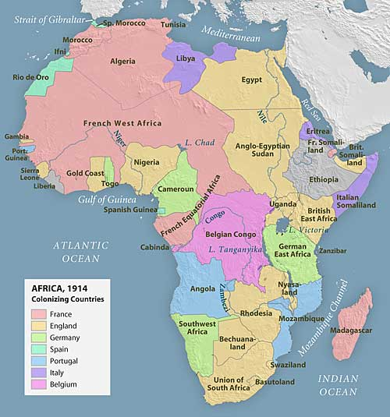

Slide 40
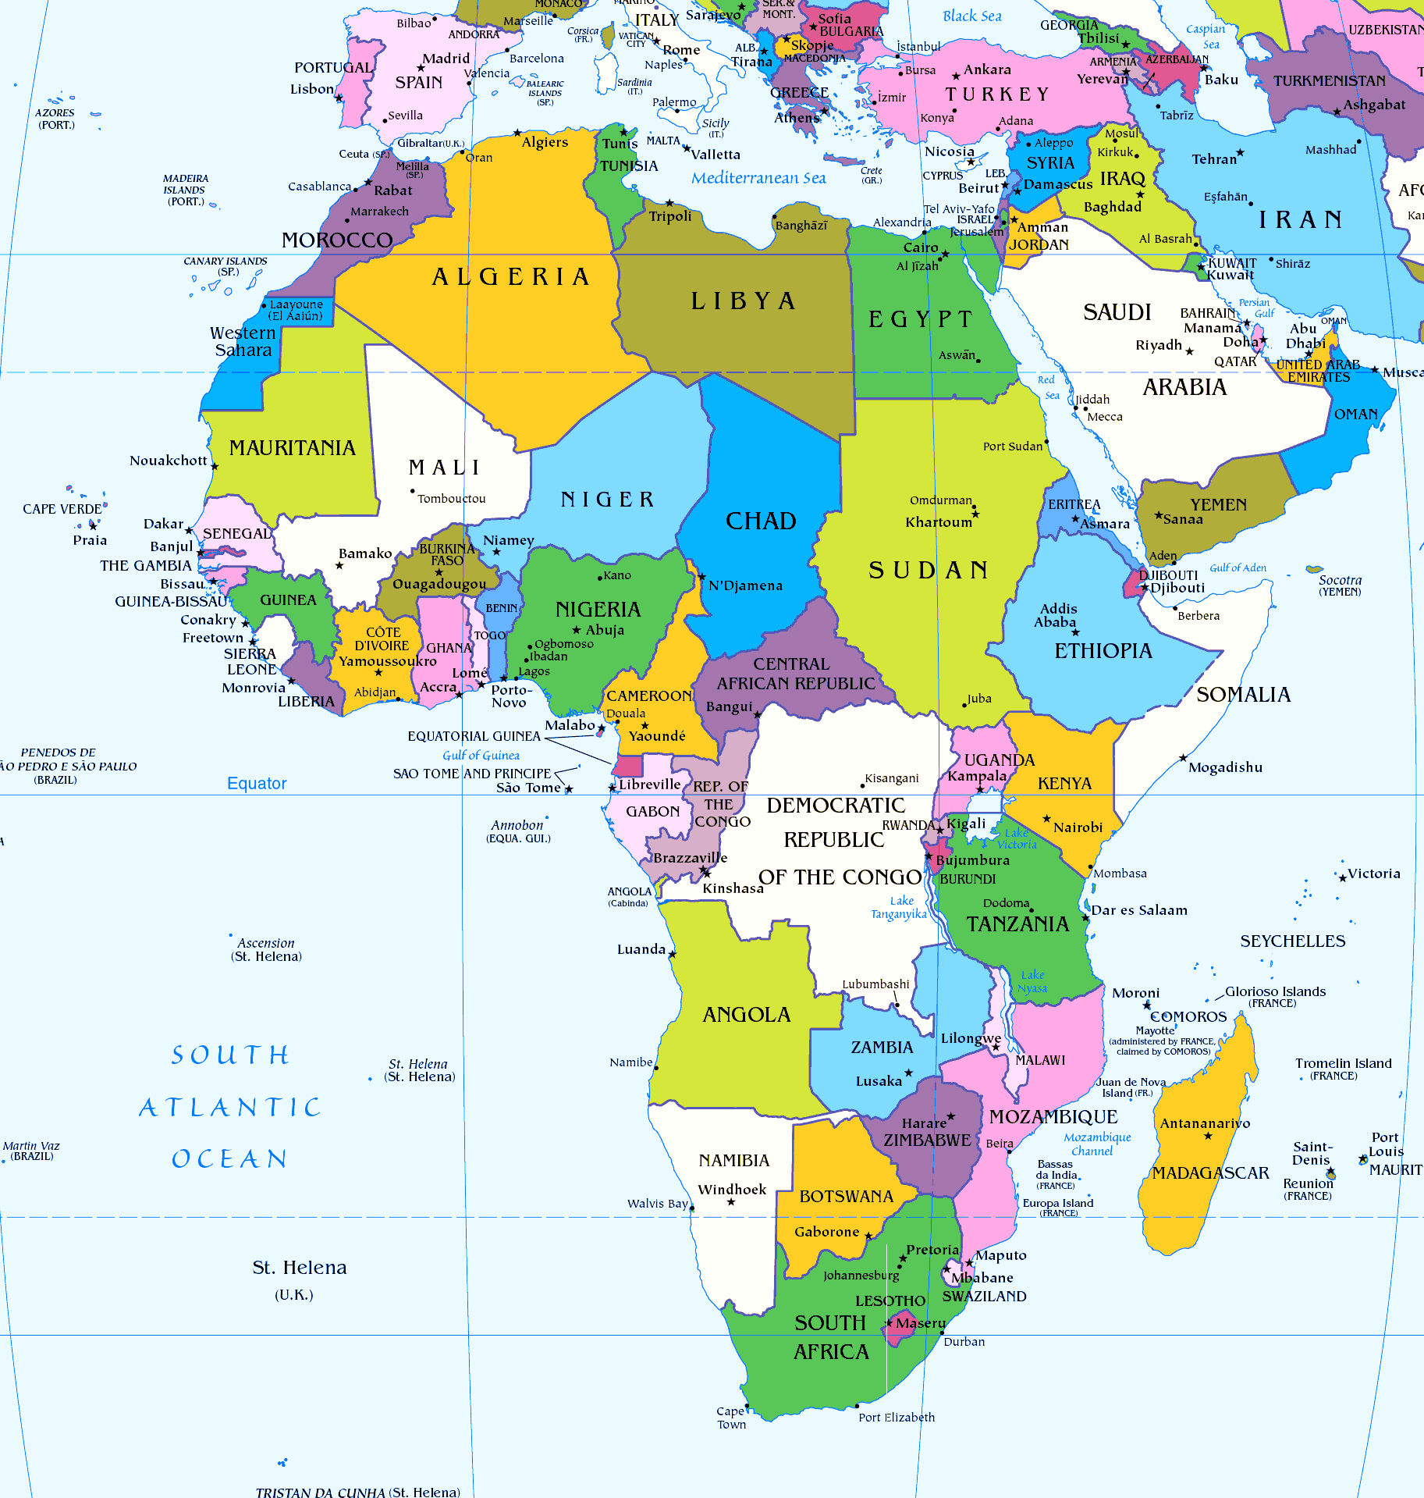

Slide 41
Is the world big enough?
There is no clear answer for this question.
As new technology is created, carrying capacity (the number of people the earth can support) increases.
Many geographers believe that there will be insufficient resources (especially food) for the growing number of people in the world.

Slide 42
Physical Geography
There are 3 important facts about the relationship between physical geography and agriculture:
1) Latitude
2) Shapes of the Continents
3) Climate, Wildlife and Plant Life

Slide 43
Latitude
Latitude is the key determinants of climate.
Near the equator, there is very little change in seasons.
In Canada, there is significant seasonal changes.

Slide 44
The Shapes of the Continents
Europe and Asia spread east-west a great distance.
Africa and the Americas spread north-south a great distance.
Continents that spread east-west have large areas with similar climate and growing seasons.

Slide 45
Continents that spread north-south lack large areas of similar climate.
Therefore, technological developments related to agriculture will not spread on these continents.

Slide 46
Climate, wildlife and plant life
Some parts of the world have a physical geography that is well suited for agriculture.
Other parts are too cold or dry cannot sustain agriculture.
Countries that can grow their own food are at a significant advantage over countries that cannot.

Slide 47
6 Key facts about the human world
The world is an unequal place, some countries are more developed than others.
The world population is increasing by 75 million people each year.
The world population will reach 9.3 billion people by 2050.

Slide 48
Most future growth in population will occur in less developed countries.
There are close relationships between world environmental regions and population distribution.
The current map of the world is not a fixed an unchanging fact.

