Slide 1
8.1 Parallel Lines

Slide 2
Parallel lines are lines that never meet. They are ALWAYS the same distance apart.

Slide 3
Use a Ruler
Draw a line.
Place one edge of the ruler along the line segment.
Draw a line segment along the other edge of the ruler.

Slide 4
Ruler and Protractor
Draw a line segment.
Choose a point on the line segment.
Place the centre of the protractor on the point.
Align the base line of the protractor with the line segment.
Make a mark at 90 degrees.
Repeat this once more.
Join the two points to draw a parallel line segment.

Slide 5
Ruler and Compass
Start with a line segment PQ and a point R off the line.

Slide 6
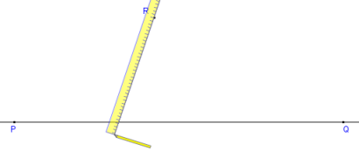
Draw a transverse line through R and across the line PQ at an angle, forming the point J where it intersects the line PQ. The exact angle is not important.

Slide 7
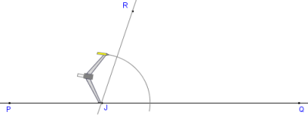
With the compass width set to about half the distance between R and J, place the point on J, and draw an arc across both lines.

Slide 8
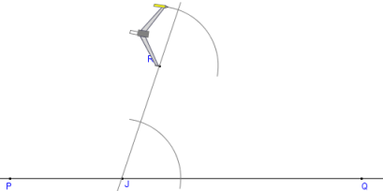
Without adjusting the compass width, move the compass to R and draw a similar arc to the one in step 2.

Slide 9
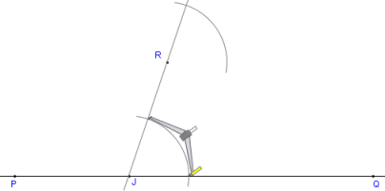
Set compass width to the distance where the lower arc crosses the two lines

Slide 10
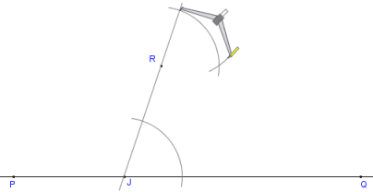
Move the compass to where the upper arc crosses the transverse line and draw an arc across the upper arc, forming point S.

Slide 11
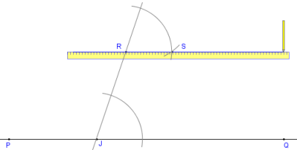
Draw a straight line through points R and S.

Slide 12
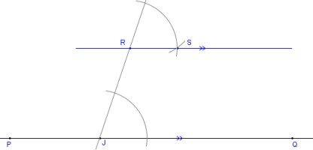
Done. The line RS is parallel to the line PQ

Slide 13
Homework
8.1 in Workbook
Textbook Page 302 # 1, 2, 3, 4, 6

