Slide 1
8.2 Perpendicular Lines

Slide 2
Two line segments are PERPENDICULAR if they intersect at Right Angles.
There are 5 ways to draw perpendicular lines.

Slide 3
Plastic Right Triangle
Draw a line segment.
Place the base of the triangle along the line segment.
Draw a line segment along the side that is the height of the triangle.

Slide 4
Paper Folding
Draw a line segment.
Fold the paper so that the line segment is aligned.
Open the paper. The fold line is a perpendicular line.

Slide 5
Ruler and Protractor
Draw a line segment.
Choose a point on the line segment.
Place the centre of the protractor on the point. Align the base of the protractor with the line segment.
Mark a point at 90 degrees and draw a line from the point to the line segment.

Slide 6
Using a Mira
Draw a line segment.
Place the Mira so that the reflection of the line segment coincides with itself when you look in the Mira.
Draw a line segment along the edge of the Mira.

Slide 7
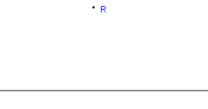
Ruler and Compass
Start with a line and point R which is not on that line.

Slide 8
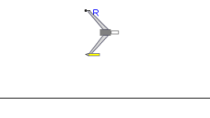
Place the compass on the given external point R.

Slide 9
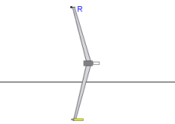
Set the compass width to a approximately 50% more than the distance to the line. The exact width does not matter.

Slide 10
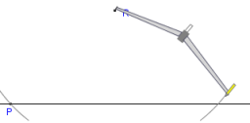
Draw an arc across the line on each side of R, making sure not to adjust the compass width in between. Label these points P and Q.

Slide 11
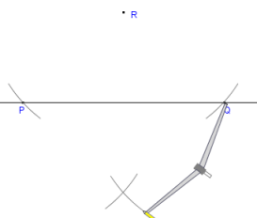
At this point, you can adjust the compass width. Recommended: leave it as is. From each point P,Q, draw an arc below the line so that the arcs cross.

Slide 12
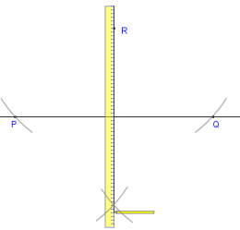
Place a straightedge between R and the point where the arcs intersect. Draw the perpendicular line from R to the line, or beyond if you wish.

Slide 13
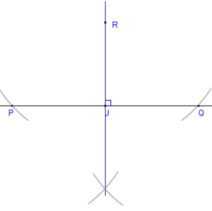
Done. This line is perpendicular to the first line and passes through the point R. It also bisects the segment PQ (divides it into two equal parts)

Slide 14
Homework
Workbook 8.2
Textbook page 305 # 1, 2, 3, 5

