Slide 1
Plot Profile
The Gruffalo

Slide 2
Plot
Things that happen in the story.
Example The mouse makes up a fictional character. The mouse tricks the Gruffalo.

Slide 3
Setting
When and where the story takes place.
Example In the middle of the deep dark wood. Present day.

Slide 4
Conflict
The problem in the story.
Example Every animal in the story wants to eat the mouse.

Slide 5
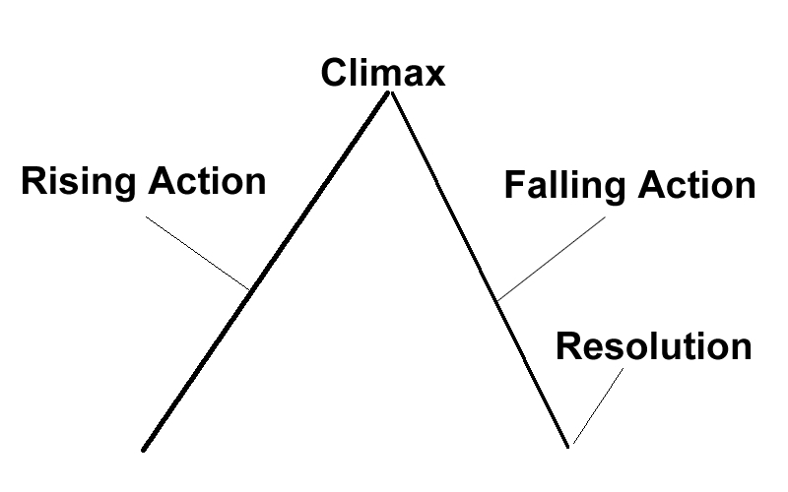
Narrative Structure
Most stories can be broken into four parts.
Identifying the turning point is the key.

Slide 6
Climax
The turning point of the story.
Example The mouse meets the Gruffalo and must save himself from the Gruffalo.

Slide 7
Rising Action
Things that happen before the climax.
Example The mouse meets other animals. The mouse creates an imaginary animal. The mouse saves himself from the other animals.

Slide 8
Falling Action
Things that happen after the climax.
Example The mouse takes the Gruffalo to meet the other animals. The Gruffalo is surprised that the other animals are “afraid” of the mouse.

Slide 9
Resolution
How the story ends.
Example The mouse enjoys a nut to himself in the deep dark wood.

Slide 10
Narrative Structure
Climax
Falling Action
Rising Action
Story
Resolution

