Slide 1
What is Geography??
What is Where, Why There, Why Care??

Slide 2
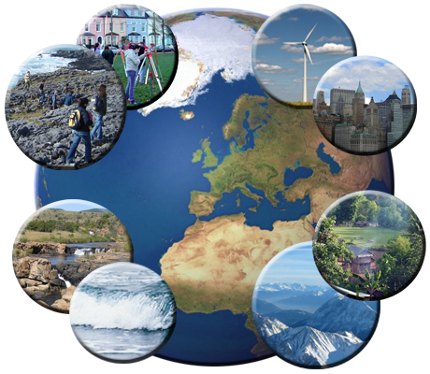

Slide 3
What is Geography?
Most people think that geography is about maps, globes, and textbooks.
Geographers describe and analyze all the different parts of the world.
Two parts of Geography are:
Physical Geography
Human Geography

Slide 4
What is Where?
Learning geography means learning about the physical world; the natural features.
This includes: land and water, climate and weather, and different landforms.
It also includes the human world. The places people live, why they live there, how they adapt to changes in the physical world, how people communicate, and how people make a living.

Slide 5
This year, you will learn where things are in the world.
Where are the continents, oceans, bodies of water, mountains etc.
Where are countries.
Where are volcanoes.
Where are deserts, icebergs.
Where are the vegetation zones.
Where do people live?

Slide 6
Why There?
Geographers explain the basic facts of geography.
For example: why rivers, farms, and cities are where they are.
Or
Why do earthquakes and hurricanes happen where they do? What impact does that have on the people that live there?

Slide 7
Why Care?
Geography matters when you need to get to school from home, when and where you decide to shop and whether you go skiing or surfing.
Many of our daily decisions are impacted by the geography around us.

Slide 8
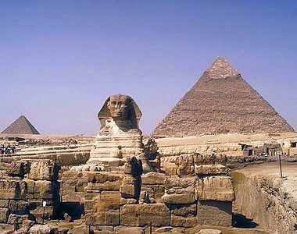
What About Cairo?
Answer the three key questions that geographers ask in regards to Cairo.
Where is Cairo?
Why is Cairo where it is?
Why should we care about Cairo? Why is it important?

Slide 9
Comprehension Quiz
What three questions do geographers ask themselves when studying a place?

Slide 10
What are the two different characteristics that geographers study?

Slide 11
Why should we care about geography?

Slide 12
Why do maps matter?

Slide 13
5 Themes of Geography
There are 5 themes of geography.
Location
Place
Humans and the environment
Movement and Globalization
Region

Slide 14
Theme 1: Location
Where is it?? Geographers answer this in 4 ways:
Absolute location
Absolute location refers to exactly where a place is on the surface of the earth.

Slide 15
Part 2:
Relative Location:
Describes a place in relation to other places.

Slide 16
Part 3:
The site characteristics of your school grounds might include flat and sandy land.
Site: Refers to the ground the location occupies.

Slide 17
Part 4:
The Situation characteristics of the school might include being close to the highway or close to a specific midan or building.
Refers to regional interdependencies. The relationship of one thing to another.

Slide 18
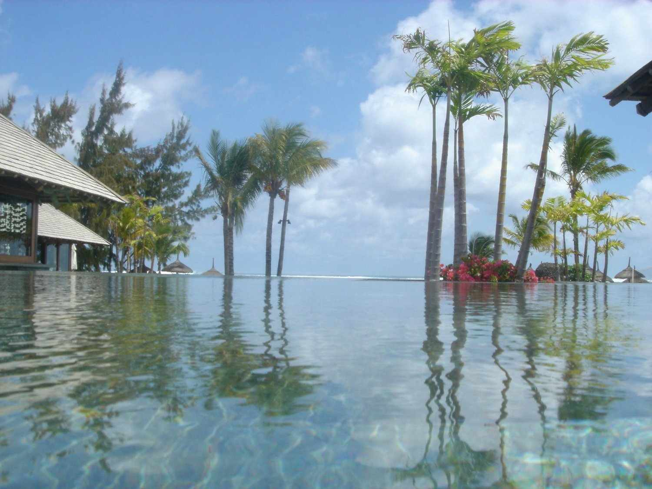
Theme 2: Place
What is it like there?
The difference between location and place is that location refers to where something is, and place describes location.
Can be described by physical characteristics and human characteristics.

Slide 19
Physical Characteristics
Includes facts like:
Temperature
Precipitation
Landforms
Drainage
Soil type
Plants
Animals

Slide 20
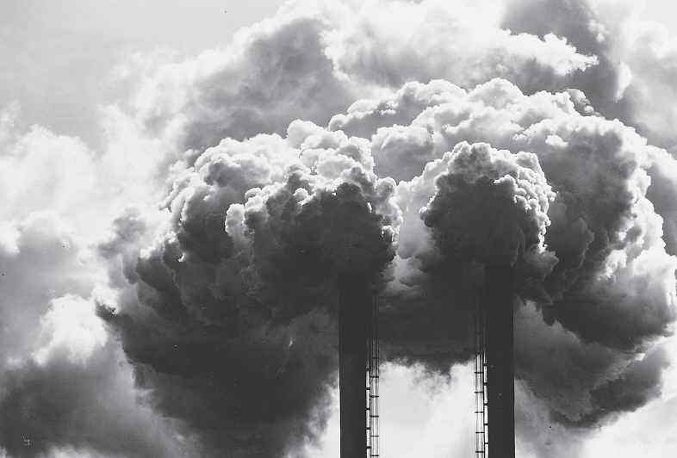
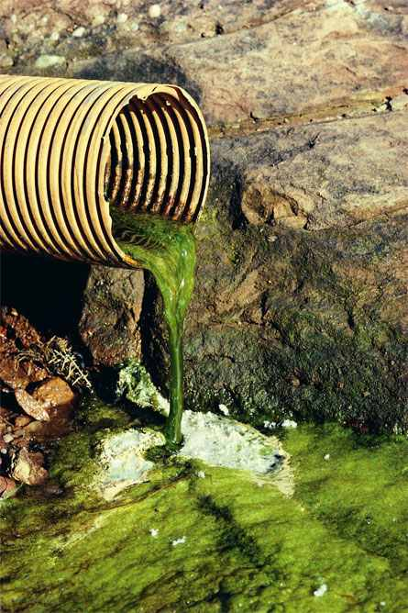
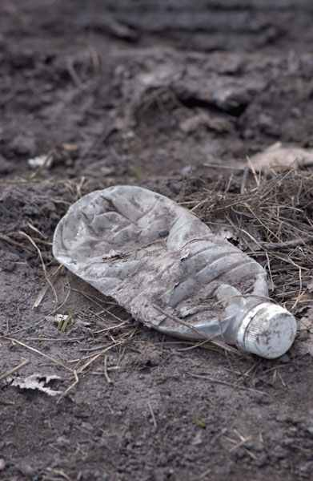
Few places on earth consist only of physical characteristics because humans have affected most places on earth.
Human impact occurs either directly or indirectly.
Direct impacts = they live there
Indirect impacts = air pollution may drift to an uninhabited area – ex. The Arctic.

Slide 21
Human Characteristics
This includes:
Population distribution and density
Settlement of rural and urban areas
Economic activities
Communication lines
Geographers study the people in each place and include language, religion and ethnic identity as part of their study.

Slide 22
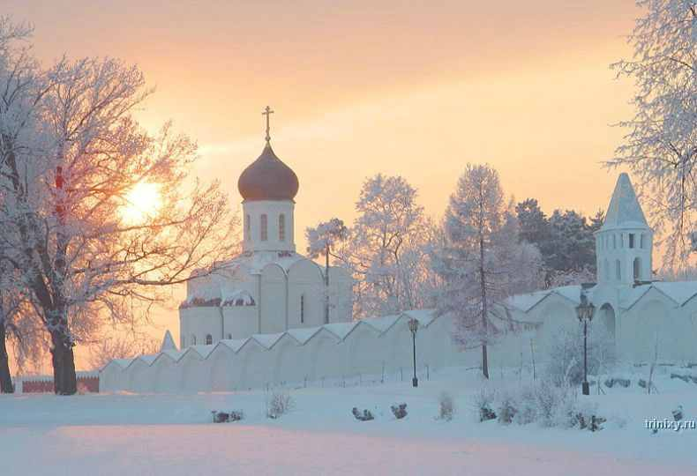

Slide 23
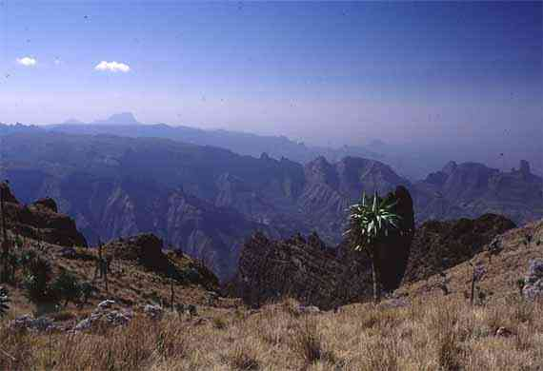

Slide 24
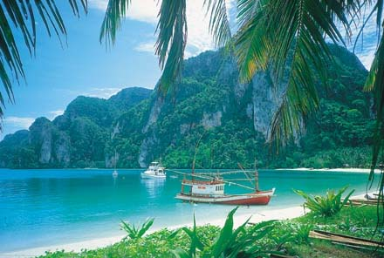

Slide 25
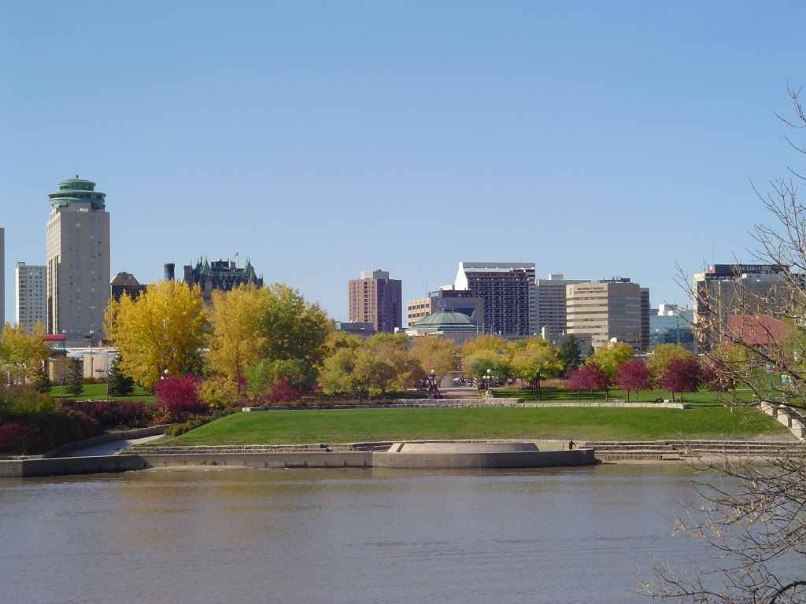

Slide 26
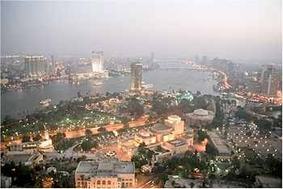

Slide 27
Theme 3: Humans and Environments
Geographers look at how humans impact the earth and how the physical characteristics impact human way of life.

Slide 28
Key Questions...
Why do humans live where they do?
How do people affect their physical environment?
In what ways do humans change their environments to make them easier to live in?
In what ways do humans depend on physical environments?
Does the environment influence humans?

Slide 29
Why is your city located where it is? Why is the area that you live in urban or agricultural?
What do you and your neighbors do that affects the physical environment? Are the effects positive or negative?
In what ways do you and your neighbors change the local environment to make it easier to live?
In what ways do you and your neighbors depend on the physical environment, locally and elsewhere?
Are you influenced by the environment? (Do you have to change what you wear or eat because of the environment)? Or, do you adapt?

Slide 30
Theme 4: Movement and Globalization
How do geographic facts interact?
Places and people do not exist separately. They interact every minute of every day.
A fundamental geographic fact is that all of us are affected by the lives and actions of others – this is called the global village.

Slide 31
Geographic Movement
1) People move from place to place as part of their everyday lives.
2) The goods that people produce move from place to place.
3) Ideas move from place to place.

Slide 32
Theme 5: Region
A region is an area on the surface of the earth distinguished from other areas by some physical and/or human characteristic.
Regions are part of the surface of the earth defined by one or more unifying characteristics.

Slide 33
There is no one correct set of regions, and the boundaries and characteristics of a region that a geographer identifies changes from time to time.

